Slide 1
Welcome to the POL 101 session on
Different types of Political Regimes
Democracy, Athoritarianism
Totalitarianism

Slide 2
Plato’s five types of regimes
The Classical Greek philosopher Plato discusses five types of regimes (Republic, Book VIII). They are Aristocracy, Timocracy, Oligarchy, Democracy, and Tyranny.
These five regimes progressively degenerate starting with Aristocracy at the top and Tyranny at the bottom.

Slide 3
Aristotle’s six-fold classification of constitution
 | Correct | Deviant
One Ruler | Kingship | Tyranny
Few Rulers | Aristocracy | Oligarchy
Many Rulers | Polity | Democracy

Slide 4
Modern classification regimes by the number of people who hold political power.
REGIMES AND NUMBER OF PEOPLE WITH POWER
Type of Regime | Number of People Who Hold Power | Example
Monarchy | One | Saudi Arabia, Jordan, Brunei, medieval England
Dictatorship | One | Cuba, North Korea, Nazi Germany
Aristocracy | A few (usually a small ruling class) | Ancient Sparta
Oligarchy | A few (usually a small group of wealthy individuals) | Renaissance Venice
Democracy | Many or all | United States, ancient Athens

Slide 5
Regimes and Amount of Government Power
Type of Regime | Amount of Governmental Power | Example
Totalitarian | Absolute power; controls every aspect of its citizens’ lives | Soviet Union, North Korea, Nazi Germany
Autocratic | Less powerful than a totalitarian regime but still controls most aspects of its citizens’ lives; often associated with a single ruler; often arbitrary | Iraq before the 2003 American invasion
Authoritarian | Less power than totalitarian regime but still controls most aspects of its citizens’ lives; often outlasts its rulers | China, Egypt
Constitutional | Limited by specific rules, such as the citizens’ right to free speech or freedom of religion | United States, United Kingdom, Germany, Japan
Anarchist | No power, or simply no government; can occur when a government loses its power | Somalia

Slide 6
Democracy

Slide 7
Democracy has roots in the Magna Carta, England's "Great Charter" of 1215 that was the first document to challenge the authority of the king, subjecting him to the rule of the law and protecting his people from feudal abuse.

Slide 8
Democracy consists of four basic elements:
A political system for choosing and replacing the government through free and fair elections.
2. The active participation of the people, as citizens, in politics and civic life.
3. Protection of the human rights of all citizens.
4. A rule of law, in which the laws and procedures apply equally to all citizens.

Slide 9
Direct democracies
A direct democracy or pure democracy is a type of democracy where the people govern directly. It requires wide participation of citizens in politics (Clifford, 2009). Athenian democracy or classical democracy refers to a direct democracy developed in ancient times in the Greek city-state of Athens.

Slide 10
Popular democracy
A popular democracy is a type of direct democracy based on referendums and other devices of empowerment and concretization of popular will.

Slide 11
Representative democracy
Representative democracy is one in which the people do not rule directly but through elected and accountable representatives.

Slide 12
Representative democracies
A representative democracy is an indirect democracy where sovereignty is held by the people's representatives.

Slide 13
A liberal democracy is a representative democracy with protection for individual liberty and property by rule of law.
An illiberal democracy has weak or no limits on the power of the elected representatives to rule as they please. (Examples?)

Slide 14
Types of representative democracy include:
Electoral democracy - type of representative democracy based on election, on electoral vote, as modern occidental or liberal democracies.
Dominant-party system – democratic party system where only one political party can realistically become the government, by itself or in a coalition government.

Slide 15
Parliamentary democracy – democratic system of government where the executive branch of a parliamentary government is typically a cabinet, and headed by a prime minister who is considered the head of government.
Westminster democracy – parliamentary system of government modeled after that of the United Kingdom system.

Slide 16
Presidential democracy- democratic system of government where a head of government is also head of state and leads an executive branch that is separate from the legislative branch.

Slide 17
Jacksonian democracy - a variant of presidential democracy popularized by U.S. President Andrew Jackson which promoted the strength of the executive branch and the Presidency at the expense of Congressional power.

Slide 18
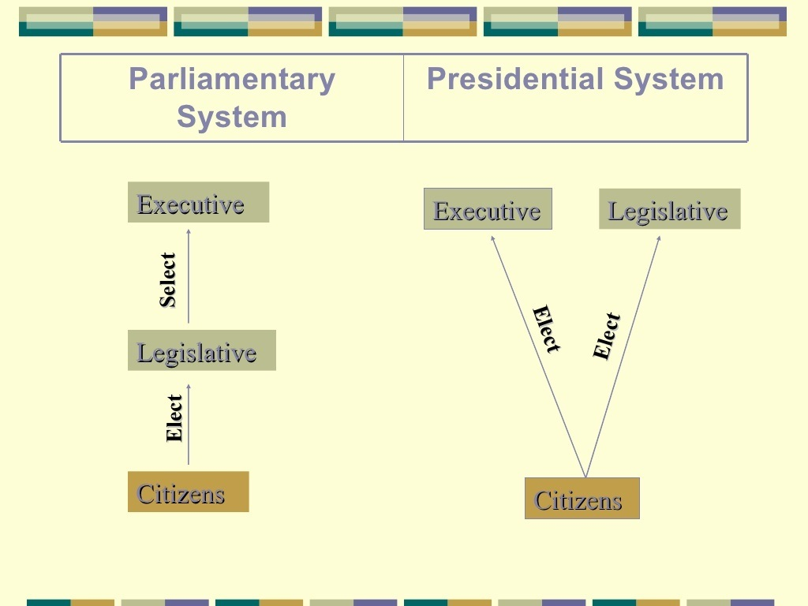

Slide 19
Soviet democracy or Council democracy – form of democracy where the workers of a locality elect recallable representatives into organs of power called soviets (councils.) The local soviets elect the members of regional soviets who go on to elect higher soviets.

Slide 20
Totalitarian Democracy- is a system of government in which lawfully elected representatives maintain the integrity of a nation state whose citizens, while granted the right to vote, have little or no participation in the decision-making process of the government.

Slide 21
Democracy is a complex and carefully balanced system that needs thoughtful citizens, limits on power, rule of law and human and civil rights.

Slide 22
Democracy does not always equal freedom
Elections, even free and fair ones, can produce regimes that ride roughshod over rights and freedom and can become illiberal democracy.

Slide 23
Referendum
Referendum is a mass vote on an issue rather than for a candidate ; a type of direct democracy which is difficult to carry out because of size.

Slide 24
Seymour M. Lipset
Democracy today is “a political system which supplies regular constitutional opportunities for changing the government officials, and a social mechanism which permits the largest possible part of the population to influence major decisions by choosing among contenders for political office.”

Slide 25
Popular Accountability of Government
In a democracy, the policymakers must obtain the support of a majority or a plurality of votes cast.
Leaders are accountable to citizens.

Slide 26
Political Competitions
Voters must have a choice, either of candidates or parties.
One- party or one-candidate elections are fake.

Slide 27
A regime that permits no opposition activity until shortly before balloting has rigged the election.
Likewise, denying media access-especially by controlling television-stunts any opposition.

Slide 28
Alternation in power
The reins of power must occasionally change hands.
Harvard political Scientist Samuel P. Huntington (1927-2008) proposed a “two turnover test” to mark a stable democracy.
Systems without alternations, such as Russia and China, are invariably corrupt.

Slide 29
Uncertain electoral outcome
Democratic elections must have an element of uncertainty, fluidity and individual vote switching.
Voting should not be simply by groups.
Examples of Iraq, South Africa

Slide 30
Majority decision
Majority should decide, the procedure used in the democracies of ancient Greece.
Majority decides with respect for minority rights.
Probably every view now widely held was once a minority view.

Slide 31
Popular representation
Some think legislators must treat elections as mandates to carry out constituents’ wishes. What the voters want is what they should get.
Others say representatives should act as constituents’ trustees, acting in the best interest of the whole.

Slide 32
Right of Dissent and Disobedience
People must have the right to resist the commands of the government they deem wrong or unreasonable.
The examples of Henry Thoreau, Mohondas Gandhi and Martin Luther King Jr..

Slide 33
Political Equality
In a democracy, all adults are equally able to participate in politics.
Under the pressure of minority claims and civil disobedience, democracies tend to open up over time and become less elite in nature.

Slide 34
Popular Consultation
Leaders must know what the people want and must be responsive to their needs and demands.
Consultation can lead to listening more to small organised groups than to ordinary citizens.

Slide 35
Free Press
Dictatorships can not tolerate free and critical mass media.
Democracies can not do without them.
No criticism, no democracy.
Does the media sometimes go ‘too far’?

Slide 36
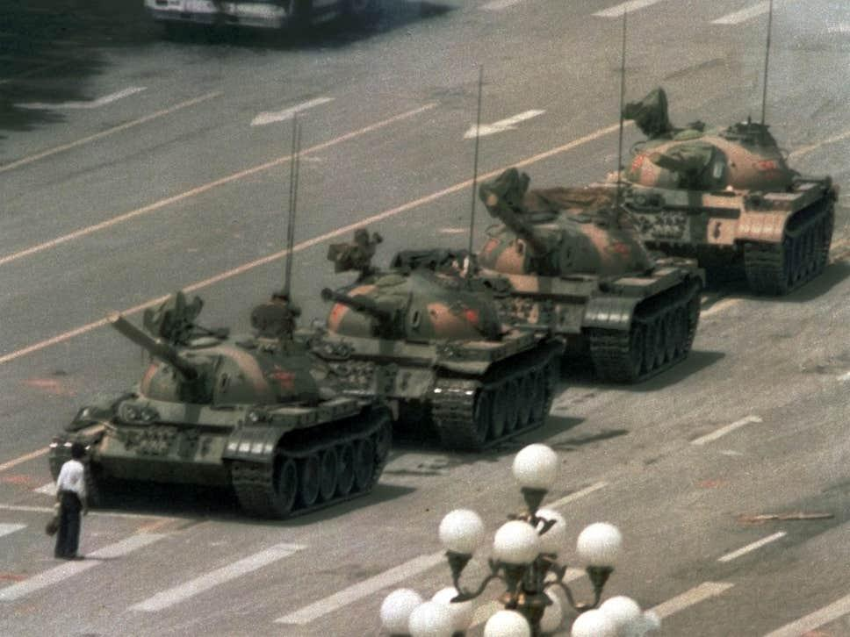

Slide 37
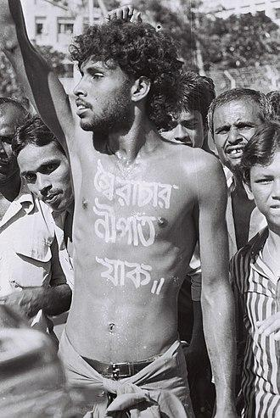

Slide 38
What really is democracy?
Elitism or pluralism?

Slide 39
Freedom House ranking of democratic countries
Bangladesh got 45 in a scale of 100. (2018)

Slide 40
END OF SESSION

